Slide 1



Employee Attrition Analysis
View in Power BI
Last data refresh:
4/5/2024 9:00:25 AM UTC
Downloaded at:
4/15/2024 9:31:08 AM UTC

Slide 2
INTRODUCTION
This project focuses on conducting Employee Attrition rate for couple of year on HR analysis . Rate is 15%. The primary goal is to uncover trends, patterns, and insights within the vast dataset, shedding light on the HR analytics consultancy for analyzing the data.

Slide 3
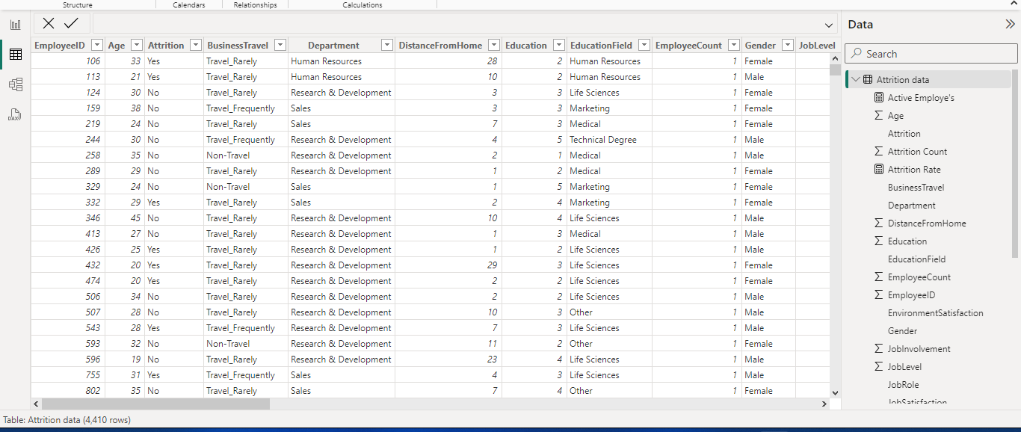
Data Collection: The dataset I used for my analysis had provided me by Unified Mentor (a remote internship provider). The dataset includes information on Age, Attrition, Job role, Gender, monthly income and Eaducational field,Employee Id, Total Working year and more. Challenges in data cleaning, profiling and normalization were addressed using Microsoft Excel and Query Editor on Power BI to ensure the accuracy of the analysis.

Slide 4
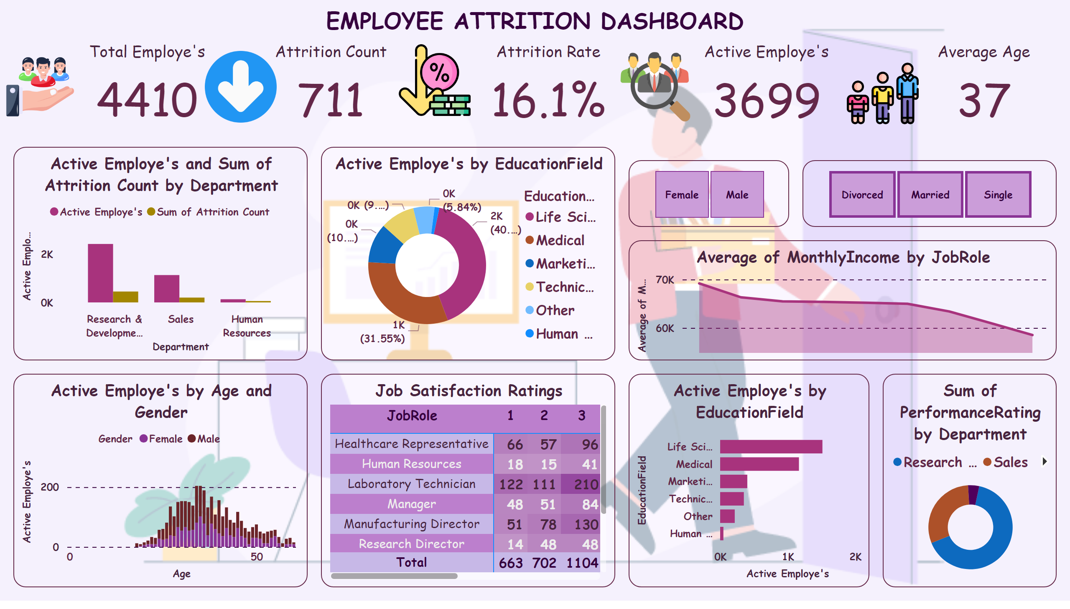
Page 1
Notes:
textbox
No alt text provided
image
No alt text provided
image
No alt text provided
image
No alt text provided
image
No alt text provided
image
No alt text provided
slicer
No alt text provided
slicer
No alt text provided
areaChart
No alt text provided
clusteredBarChart
No alt text provided
donutChart
No alt text provided
Job Satisfaction Ratings
No alt text provided
columnChart
No alt text provided
donutChart
No alt text provided
clusteredColumnChart
No alt text provided
Average Age
No alt text provided
Active Employe's
No alt text provided
Attrition Rate
No alt text provided
Attrition Count
No alt text provided
Total Employe's
No alt text provided

Slide 5
THANK YOU

